Slide 1
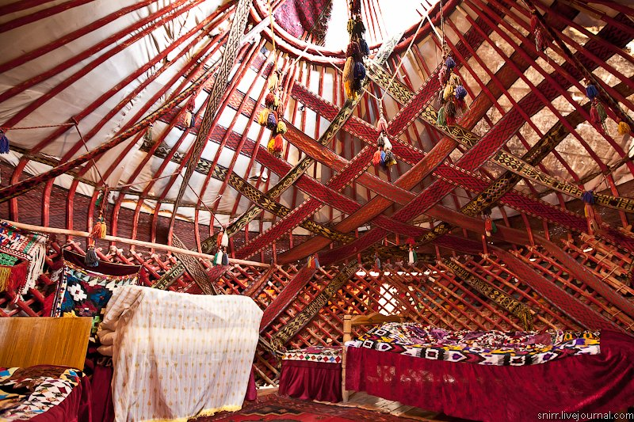


Full itinerary and detailed information about the trip.
Cultural heritage and natural beauty of Karakalpakstan
BEST CHOICE
BEST PRICES
RELIABLE TEAM

Slide 2

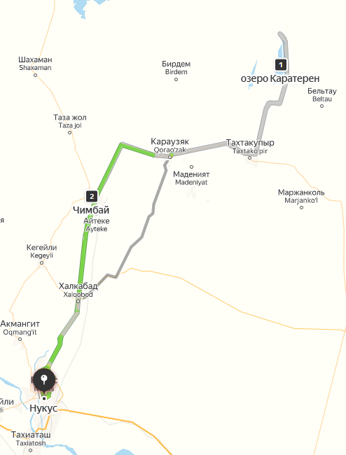
Trip itinerary
Duration:
2 days/1 night
Tour season:
Year-round
Total distance:
More than 300 km
Meals:
4 times
Transport:
Sedan / Minibus

Slide 3

Day 1: Nukus – Ishan Kala – Karateren
Start point:
Nukus city (Railway Station, Airport, Hotel, etc.)
09:00 — Meeting and start of the tour in Nukus.
Visit to the I. V. Savitsky State Museum of Arts of the Republic of Karakalpakstan. The museum is famous for its unique collection of Russian and Soviet avant-garde of the 1920s and 1930s, which helps to rethink the history of art in an international context. Collections of folk and applied arts and archaeological finds from Ancient Khorezm are also presented.11:00 — Excursion to the Museum of History and Culture of Nukus.
The museum, founded in 1929, is one of the oldest scientific and educational institutions in the Aral Sea region and Central Asia. There are exhibits telling about the history, culture and nature of the region.13:00 — Lunch at the guest house.
National dishes: beshbarmak, aksaulak, majek burek, zhugeri gurtik.14:00 — Departure to Ishan Kala.
14:30 — Arrival at the historical and architectural complex "Ishan Kala".
This monument of the XVIII–XIX centuries is located in the Kegeylinsky district, on the territory of the Juzim-Bagh MFC.15:30 — Departure to the Karateren yurt complex.
16:30 — Arrival and free time at the yurt complex.
Activities: boating, hiking in the mountains, fishing and enjoying nature.18:00 — Dinner and overnight at the yurt complex.
Day 2: Karateren – Chimbay - Nukus
08:00 — Wake up and breakfast.
09:00 — Departure to Chennai.
10:00 a.m. — Arrival in Chimbay.
The city was founded in the XVII century as a fortress of fishermen and cattle breeders. During the archaeological excavations of 1976-1977, artifacts dating back to the VII–VIII centuries were discovered.10:30 — Visit to the workshop for the manufacture of Karakalpak national musical instruments. Tourists will learn about their history and will be able to observe the creation process.11:00 — Visit to the artisans who are engaged in the production of carpet strips for yurts.12:00 — Excursion to the workshop for the creation of Karakalpak yurts. The tour participants will be able to see the construction process and try their hand.13:00 — Lunch at the national house.14:00 — Departure to Nukus.
15:00 — Arrival in Nukus and the end of the tour.

Slide 4
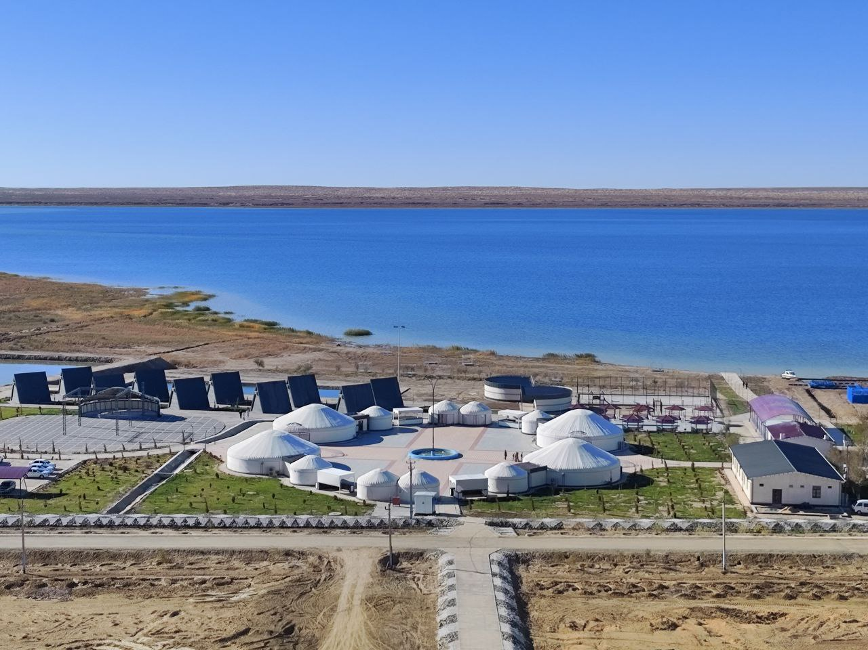
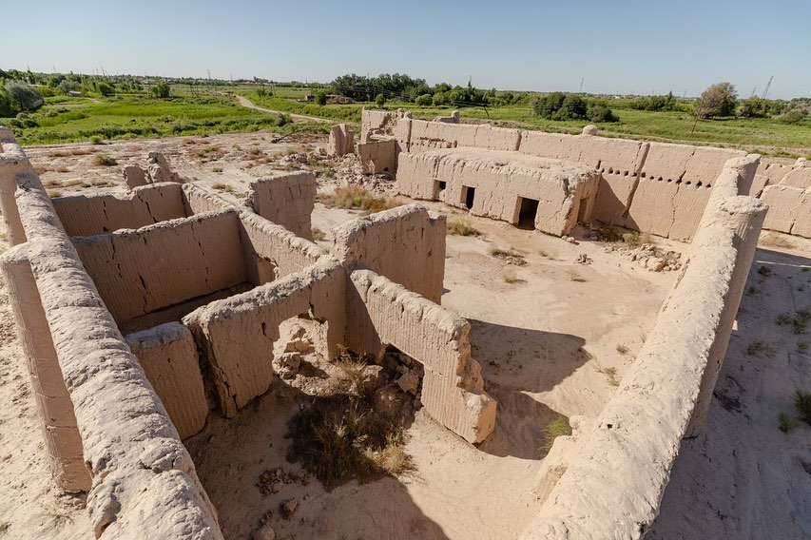
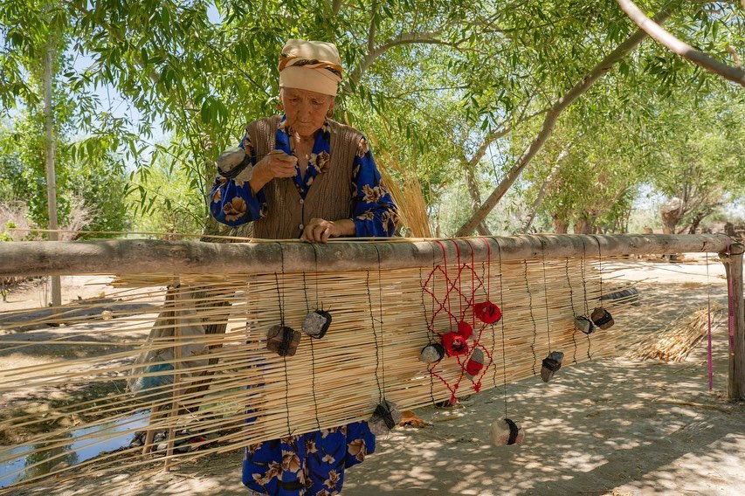
www.besqala.com

Slide 5
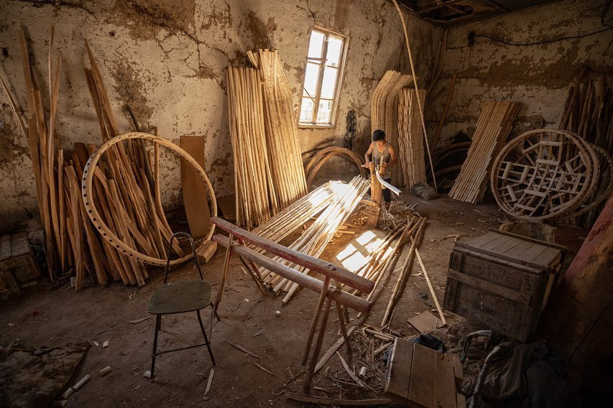
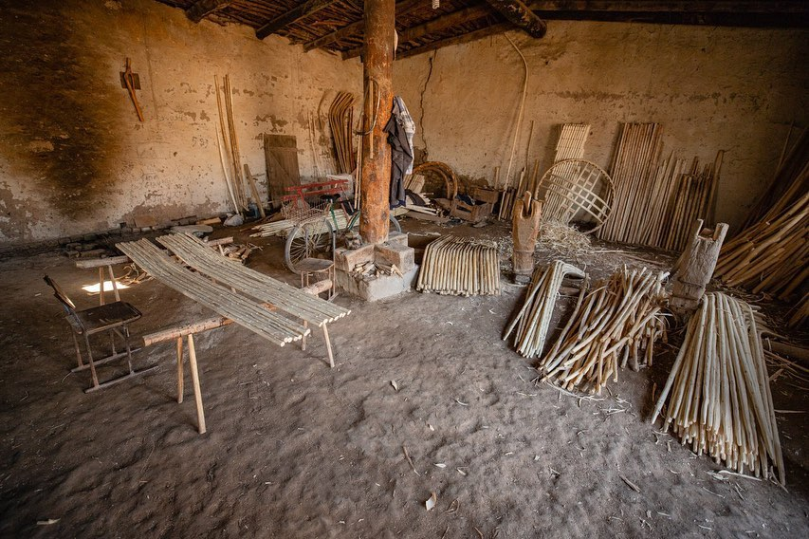
www.besqala.com

